Slide 1
Understanding Intentions through Human teaching motions
B4 komota Tetsuya

Slide 2
Background
It is expected to realize a general-purpose robot which are able to do task in the human living environment.
General-purpose robots need the ability to learn the behavior from the interaction with humans.
→It is NOT just “imitation”.
The ability to learn the human intentions from the human motions is necessary.
It enables robots to predict the task goal.

Slide 3





Background
Ex) The task “Take the cup.”
Teaching the task
Just imitation
Take the cup.
Take the cup.

Slide 4







Background
Ex) The task “Take the cup.”
Reproduction with human intention.
The human
position
is important.
Take
the cup.
Teaching the task.

Slide 5
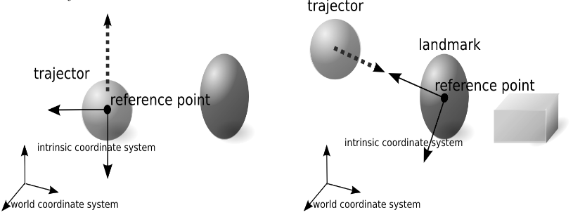
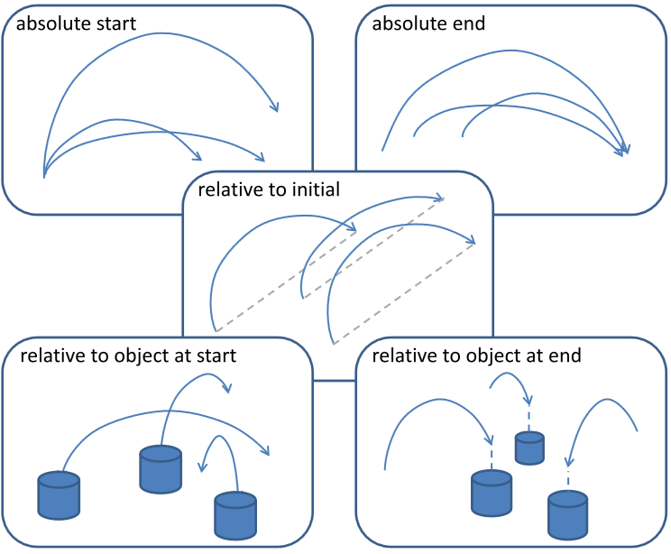
Related Works
Motions
= The combination of pre-programmed trajectory .
[Dong 2012]
→It can’t handle unexpected tasks.
Human Intention
= A position of Landmark
+ Coordinate System
[Sugiura 2011]
→it can't handle the tasks with multi reference points.

Slide 6
Proposed Method
Word Definition
Task : The pair of start positions and goal positions of the all objects.
Viewpoints : The human intention, which influence to decide a goal of trajector.
Reference points : the origin to decide the viewpoints.
(ex. Position of objects , center of environment)
Viewpoint = Reference point + Displacement

Slide 7
Reference Point
The tasks (deciding the goal point) include the following types.
1.Constant displacement.
2.Constant position.
3. according to the position of the other objects.
If the point of center and the start of trajector are included to the reference points , the 1. and 2. tasks can be included to the 3. tasks.

Slide 8

Reference Point
The tasks (deciding the goal point)
include the following types.
1.Constant displacement.
2.Constant position.
3. according to the position of
other objects.

Slide 9
Displacement
The displacements include the following types.
1.Constant direction.
2.According to the position of the trajector and reference points.
3.According to the position of the reference point and the objects.
in order to distinguish these, it is necessary to consider the several coordinate system.

Slide 10
Displacement
The displacements include the
following types.
1.Constant direction.
2.According to the position of the
trajector and reference points.
3.According to the position of the
reference point and the objects.
Right of the blue.
Near of the blue.
Line up clockwise.

Slide 11
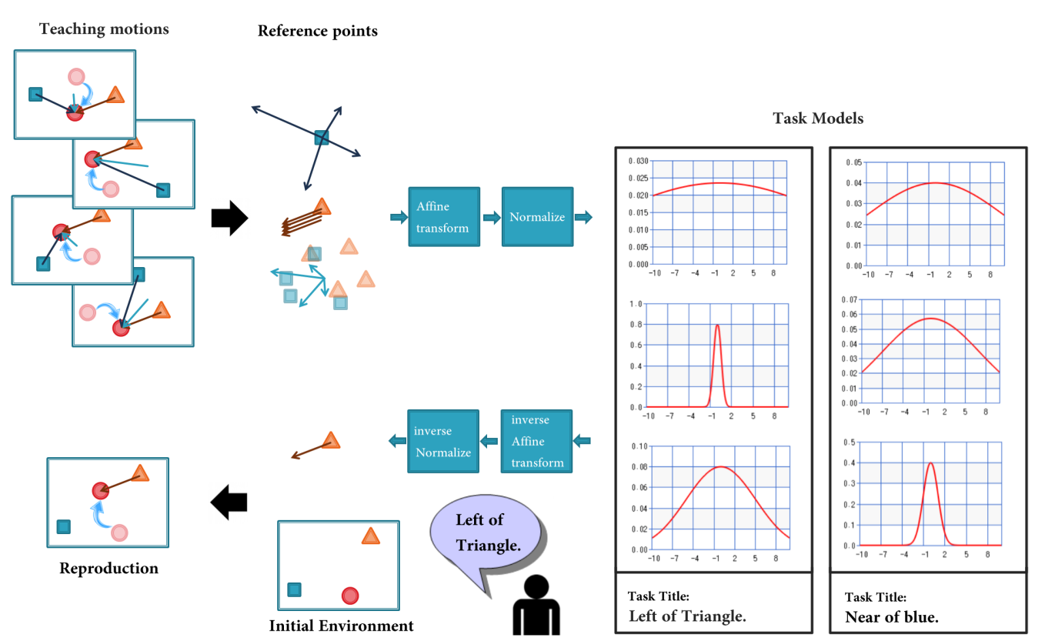
Model

Slide 12
Teaching phase
The teacher shows some motions in different initial environments.

Slide 13
Teaching phase
In each motion, It gets the vectors from each reference point to the trajetor’s goal position.

Slide 14

Teaching phase
For the square
For the triangle
For the point of gravity of the two

Slide 15
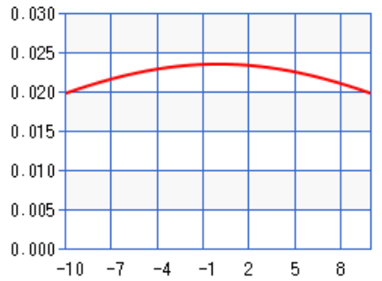
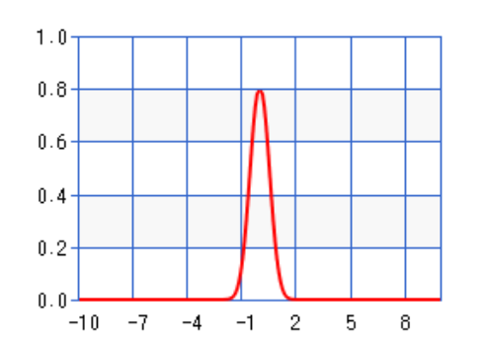
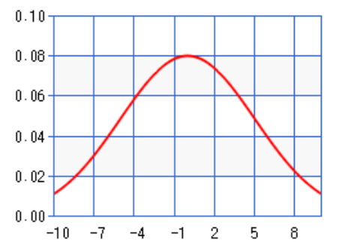
Affine
transform
Normalize

Slide 16
Model

Slide 17
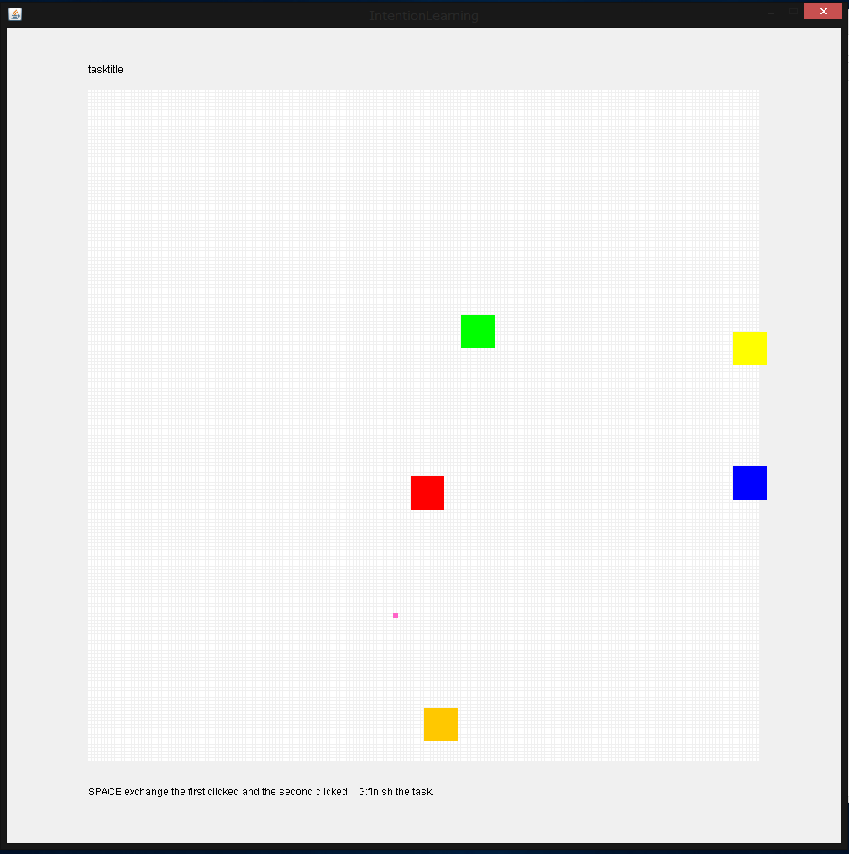
Experiments
Environments
Serial-2D map.
There are a trajector
and 4 objects.
For the computer,
Known:
Map range, the number of objects,
These positions, the kind of viewpoints
Unknown:
The true viewpoint for the task.

Slide 18
Experiments
The tasks learned by the computer are the following.
1.Move the red to the center.
2.Move the red to right of the blue.
3.Move the red to the near of the orange.
4.Move the red away from the green.
5.Move the red to line up the red ,yellow and blue equidistantly.
6. Move the red to line up the red , green and blue clockwise.
Success : Appropriate viewpoints was chosen.

Slide 19
Results
When you do a poor teaching , it can’t guess the intention accurately.

Slide 20

Identification Experiments
He did
“Take the cup.”

Slide 21
Identification Experiments
The tasks learned by the computer are the following.
1.Move the red to the center.
2.Move the red to right of (each 4 object).
3.Move the red to the near of (each 4 object).
4.Move the red away from (each 4 object).
5.Move the red to line up the red ,yellow and blue equidistantly.
6. Move the red to line up the red , green and blue clockwise.
The computer answers the best likely Task.
Success : Appropriate task was chosen.

Slide 22
Results
Task name | Count of error | Success rate
Move the red to the center. | 4 | 0.96
Move the red to the right of the blue. | 2 | 0.98
Move the red to the near of the orange. | 3 | 0.97
Move the red away from the green. | 3 | 0.97
Move to line up equidistantly. | 0 | 1
Move to line up clockwise. | 4 | 0.96

Slide 23
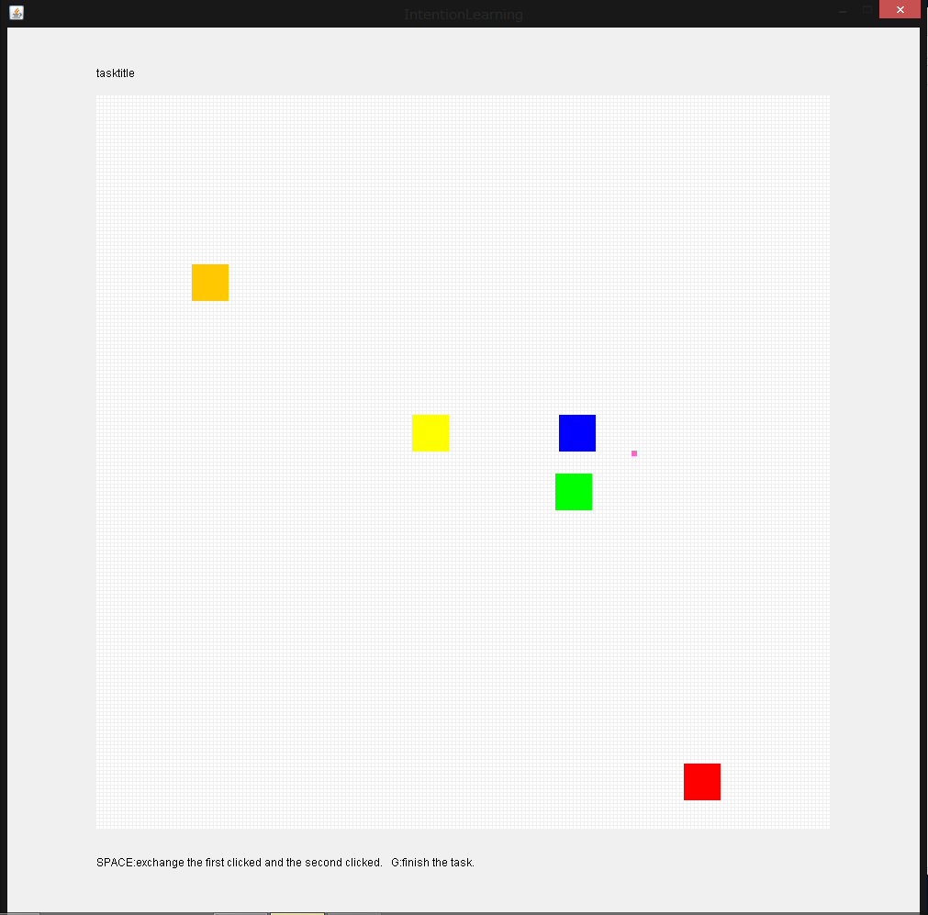
Results
The examples of false identification.
True : away from the green
Answer : near of the orange
True : right of the blue
Answer : line up clockwise

Slide 24
Conclusion
I aimed to enable the computer to understand the human intention from the human motion and to reproduce the task in consideration of the human intention.
The proposed method enable to recognize the motion in consideration of the positions of multi objects.

Slide 25
Future works
More Highly
1. Learning the sequence of the task primitives.
2. Limitation the range to attention.
3. Test other learning models.
More General
1. Using general features to recognize intention.
2. Learning the multi-goal tasks.
More Useful
1. Neglect the false teaching motion.
2. Combination of NLP.

Slide 26
References
[1]中岡慎一郎, et al. "シンボリックな動作記述を用いた舞踊動作模倣ロボットの実現." 電子情報通信学会技術研究報告. PRMU パターン認識・メディア理解 103.390 (2003): 55-60.
[2]Schaal, Stefan. "Dynamic movement primitives-a framework for motor control in humans and humanoid robotics." Adaptive Motion of Animals and Machines. Springer Tokyo, 2006. 261-280.
[3]杉浦孔明, et al. "Learning, generation and recognition of motions by reference-point-dependent probabilistic models." Advanced Robotics 25.6-7 (2011): 825-848.
[4]Dong, Shuonan, and Brian Williams. "Learning and recognition of hybrid manipulation motions in variable environments using probabilistic flow tubes." International Journal of Social Robotics 4.4 (2012): 357-368.

Slide 27
Results
The unit = length of the object/10
Teaching error = the variance of the teaching motion.
Reproduction error = the standard deviation of the reproduced motion.

Slide 28
Results
The unit = length of the object/10
Teaching error = the variance of the teaching motion.
Reproduction error = the standard deviation of the reproduced motion.

Slide 29
Results
The unit = length of the object/10
Teaching error = the variance of the teaching motion.
Reproduction error = the standard deviation of the reproduced motion.

Slide 31
Affine
transform
Normalize

